Slide 1
JSALT 2023
Prone Optimization (e.g. Optimisation)
Ben Irving, Sandeep Polisetty, John E. Ortega

Slide 2
Current Bottlenecks
Truncated SVD (not using a framework but similar to others)
3 major bottlenecks identified
Pre-factorization (getting the orthogonal values) from the original graph.
Chebyshev Polynomial, 10 “Bessel” steps.
Converting the truncated (sparse) matrix to a dense.

Slide 3
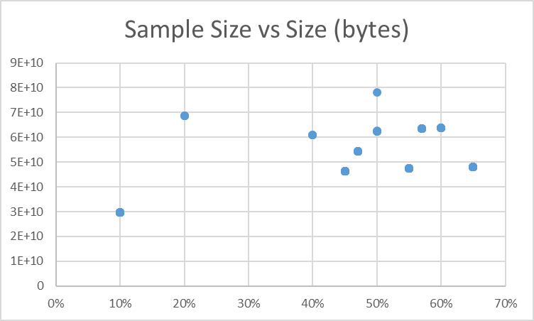
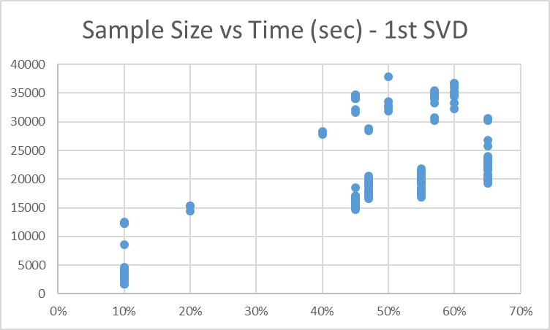
Current Bottlenecks
Pre-factorization (the first SVD) step
Simple (2-dim) metrics for down-sampled executions.
(Not realistic but gives an idea of how runs are increasing in time and size)

Slide 4
Facilities Performed
Broken up into 3 “phases” where facilities have been executed
Pre-factorization saves the “U” values to disk from SVD
Chebyshev uses the “U” to create and save to disk the “Lx1” which is the first Chebyshev polynomial needed. The final “conv” file is saved which uses Lx0 and Lx1 to finalize the Chebyshev using the Bessel function.
Final SVD is saved from the above to disk (a dense SVD created to maintain the orthogonal values of the original G)

Slide 5
Next Steps
Use the provided facilities to run experiments and measure time save. (Ken--Ben/John)
Attempt to run the matrix multiplications using PyTorch (the pre-factorization step is the one that takes the most time). (Sandeep)
Learn why the default number of Bessel steps in the 2nd Phase (Chebyshev) is 10. Could we use less or more depending on the size of the matrix (K)? (Ben/John)
Other improvement ideas such as SVD PyTorch and/or smaller thetas (co-variates when calculating the Chebyshev). (Ben/John)

